Slide 1
NONTRADITIONAL MACHINING AND THERMAL CUTTING PROCESSES
Mechanical Energy Processes
Electrochemical Machining Processes
Thermal Energy Processes
Application Considerations

Slide 2
Nontraditional Processes Defined
A group of processes that remove excess material by various techniques involving mechanical, thermal, electrical, or chemical energy (or combinations of these energies)
They do not use a sharp cutting tool in the conventional sense

Slide 3
Importance of Nontraditional Processes
Need to machine newly developed metals and non‑metals with special properties that make them difficult or impossible to machine by conventional methods
Need for unusual and/or complex part geometries that cannot readily be accomplished by conventional machining
Need to avoid surface damage that often accompanies conventional machining

Slide 4
Classification of Nontraditional Processes
Mechanical ‑ typical form of mechanical action is erosion of work material by a high velocity stream of abrasives or fluid (or both)
Electrical ‑ electrochemical energy to remove material (reverse of electroplating)
Thermal – thermal energy usually applied to small portion of work surface, causing that portion to be fused and/or vaporized

Slide 5
Mechanical Energy Processes
Ultrasonic machining
Water jet cutting
Abrasive water jet cutting
Abrasive jet machining

Slide 6
Ultrasonic Machining (USM)
Abrasives contained in a slurry are driven at high velocity against work by a tool vibrating at low amplitude and high frequency
Tool oscillation is perpendicular to work surface
Abrasives accomplish material removal
Tool is fed slowly into work
Shape of tool is formed into part

Slide 7
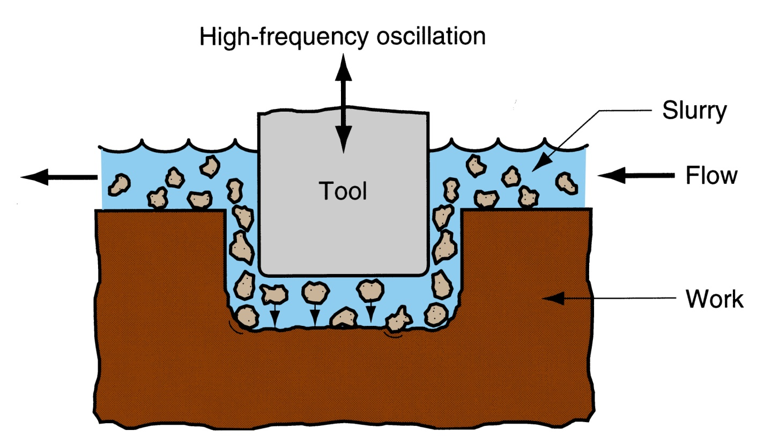
Ultrasonic Machining
Figure 26.1 Ultrasonic machining.

Slide 8
USM Applications
Hard, brittle work materials such as ceramics, glass, and carbides
Also successful on certain metals, such as stainless steel and titanium
“Coining operations” - pattern on tool is imparted to a flat work surface

Slide 9
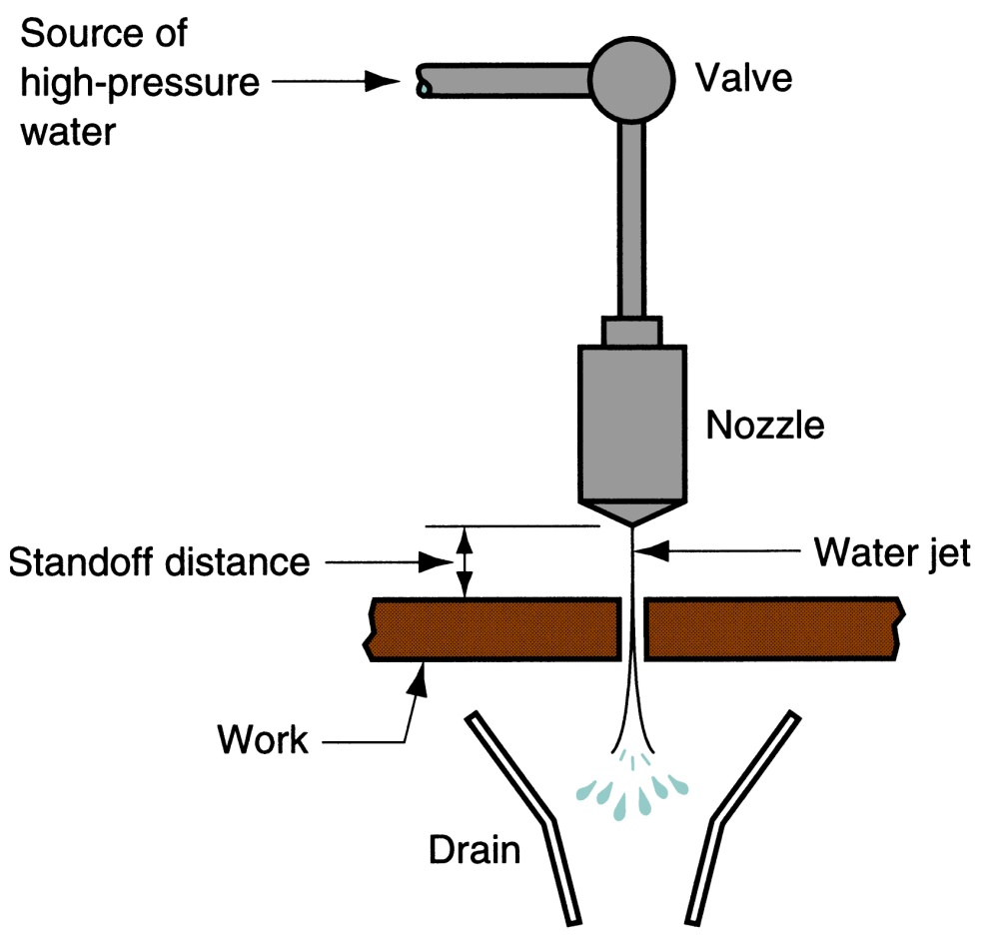
Water Jet Cutting (WJC)
Uses high pressure, high velocity stream of water directed at work surface for cutting
Water jet cutting.

Slide 10
WJC Applications
Usually automated by CNC or industrial robots to manipulate nozzle along desired trajectory
Used to cut narrow slits in flat stock such as plastic, textiles, composites, floor tile, carpet, leather, and cardboard
Not suitable for brittle materials (e.g., glass)

Slide 11
WJC Advantages
No crushing or burning of work surface
Minimum material loss
No environmental pollution
Ease of automation

Slide 12
Abrasive Water Jet Cutting (AWJC)
When WJC is used on metals, abrasive particles must be added to jet stream usually
Additional process parameters: abrasive type, grit size, and flow rate
  Abrasives: aluminum oxide, silicon dioxide, and garnet (a silicate mineral)
  Grits added to water stream at about 0.25 kg/min (0.5 lb/min) after it exits nozzle

Slide 13
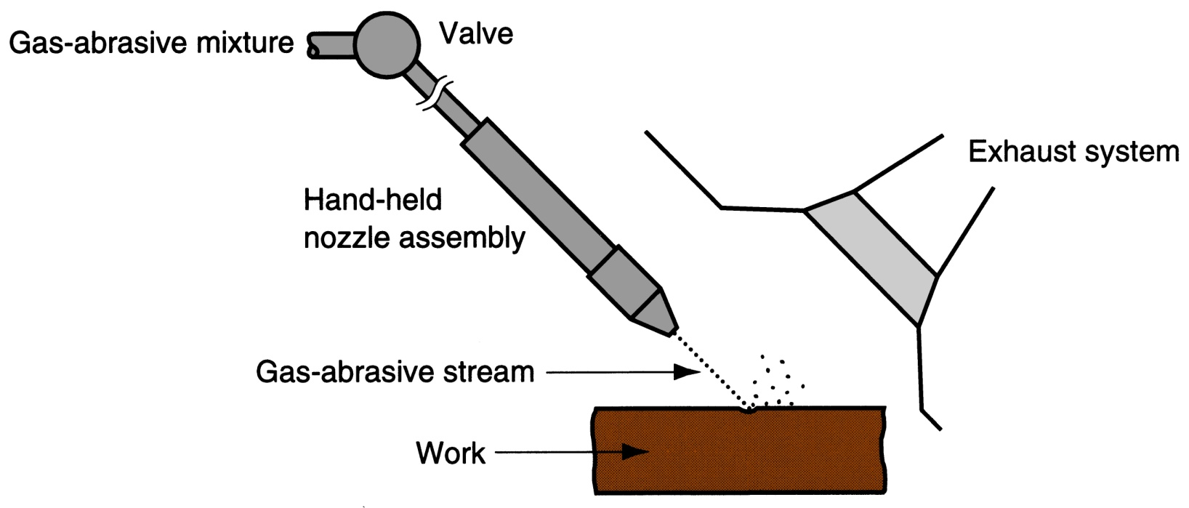
Abrasive Jet Machining (AJM)
High velocity stream of gas containing small abrasive particles
Figure 26.4 Abrasive jet machining (AJM).

Slide 14
AJM Application Notes
Usually performed manually by operator who directs nozzle
Normally used as a finishing process rather than cutting process
Applications: deburring, trimming and deflashing, cleaning, and polishing
Work materials: thin flat stock of hard, brittle materials (e.g., glass, silicon, mica, ceramics)

Slide 15
Electrochemical Machining Processes
Electrical energy used in combination with chemical reactions to remove material
Reverse of electroplating
Work material must be a conductor
Processes:
  Electrochemical machining (ECM)
  Electrochemical deburring (ECD)
  Electrochemical grinding (ECG)

Slide 16
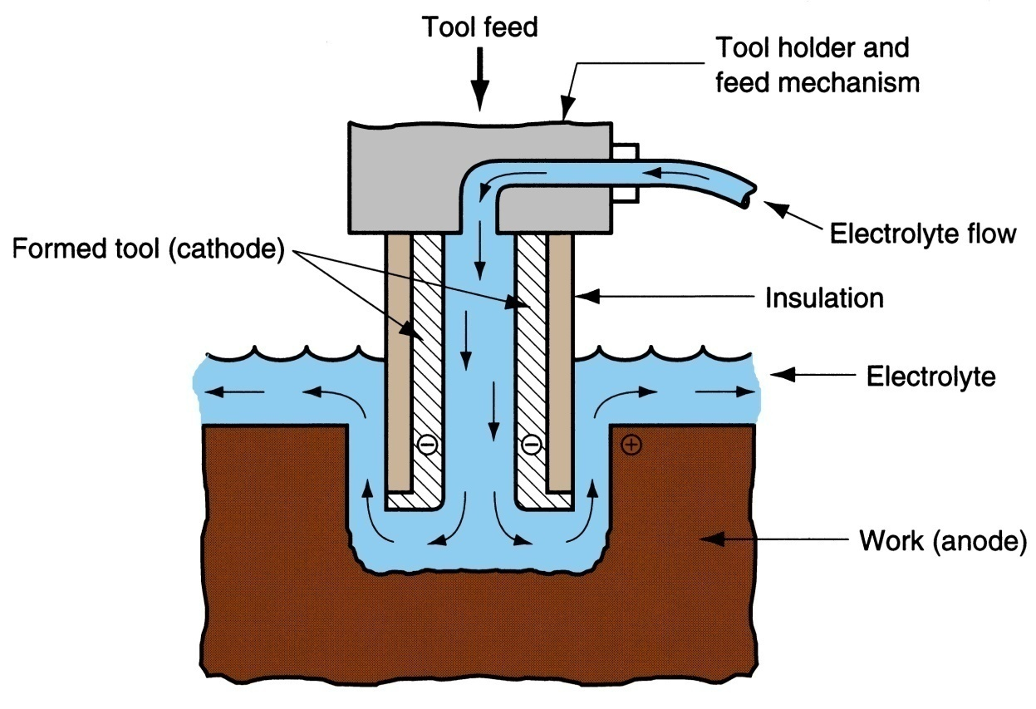
Electrochemical Machining (ECM)
Material removal by anodic dissolution, using electrode (tool) in close proximity to work but separated by a rapidly flowing electrolyte
Figure 26.5
Electrochemical machining (ECM).

Slide 17
ECM Operation
Material is deplated from anode workpiece (positive pole) and transported to a cathode tool (negative pole) in an electrolyte bath
Electrolyte flows rapidly between two poles to carry off deplated material, so it does not plate onto tool
Electrode materials: Cu, brass, or stainless steel
Tool has inverse shape of part
  Tool size and shape must allow for the gap

Slide 18
ECM Applications
Die sinking - irregular shapes and contours for forging dies, plastic molds, and other tools
Multiple hole drilling - many holes can be drilled simultaneously with ECM
Holes that are not round, since rotating drill is not used in ECM
Deburring

Slide 19
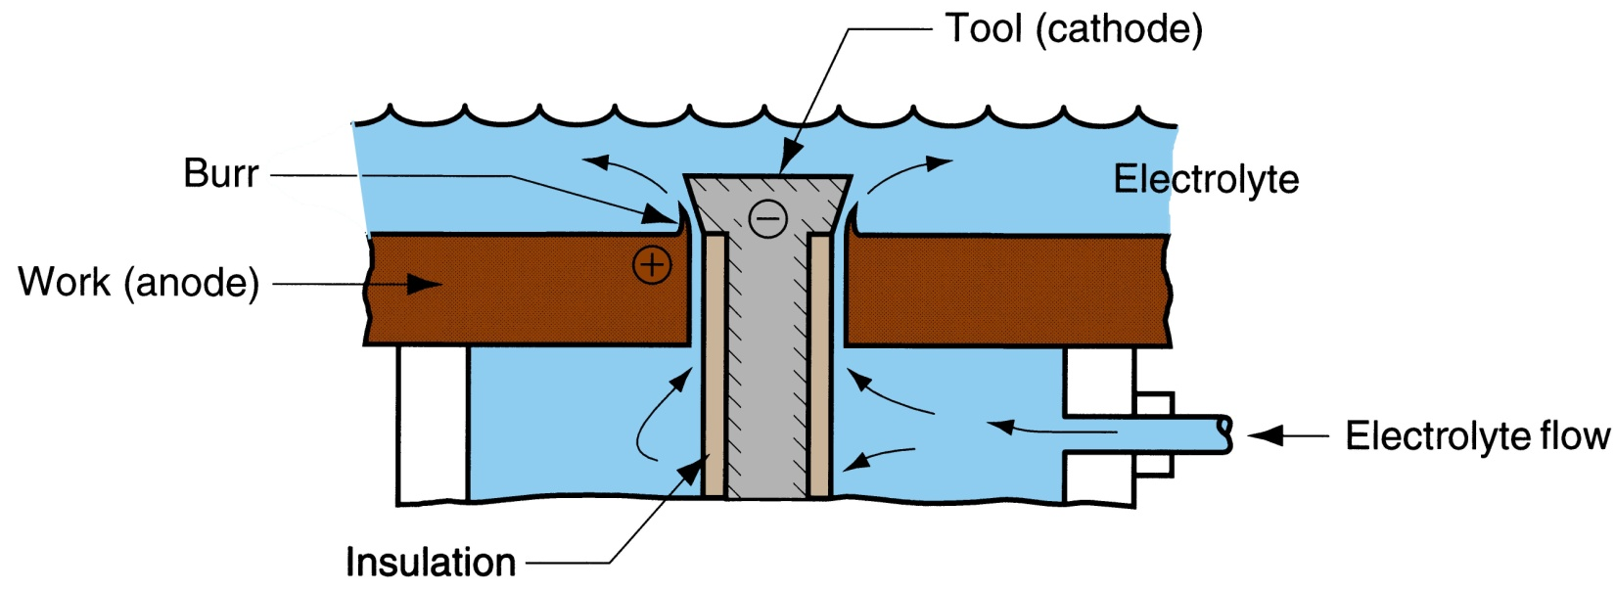
Electrochemical Deburring (ECD)
Adaptation of ECM to remove burrs or sharp corners on holes in metal parts produced by conventional through‑hole drilling
Figure 26.6 Electrochemical deburring (ECD).

Slide 20
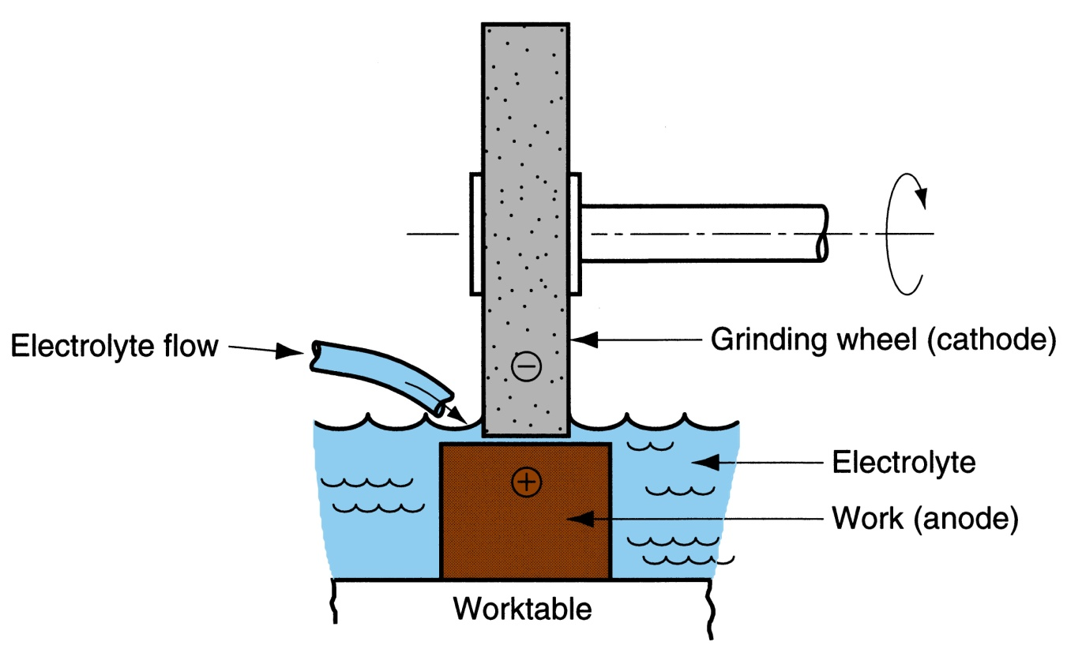
Electrochemical Grinding (ECG)
Special form of ECM in which grinding wheel with conductive bond material augments anodic dissolution of metal part surface
Figure 26.7
Electrochemical grinding (ECG)

Slide 21
Applications and Advantages of ECG
Applications:
  Sharpening of cemented carbide tools
  Grinding of surgical needles, other thin wall tubes, and fragile parts
Advantages:
  Deplating responsible for 95% of metal removal
  Because machining is mostly by electrochemical action, grinding wheel lasts much longer

Slide 22
Thermal Energy Processes - Overview
Very high local temperatures
  Material is removed by fusion or vaporization
Physical and metallurgical damage to the new work surface
In some cases, resulting finish is so poor that subsequent processing is required

Slide 23
Thermal Energy Processes
Electric discharge machining
Electric discharge wire cutting
Electron beam machining
Laser beam machining
Plasma arc machining
Conventional thermal cutting processes

Slide 24
Electric Discharge Processes
Metal removal by a series of discrete electrical discharges (sparks) causing localized temperatures high enough to melt or vaporize the metal
Can be used only on electrically conducting work materials
Two main processes:
  Electric discharge machining
  Wire electric discharge machining

Slide 25
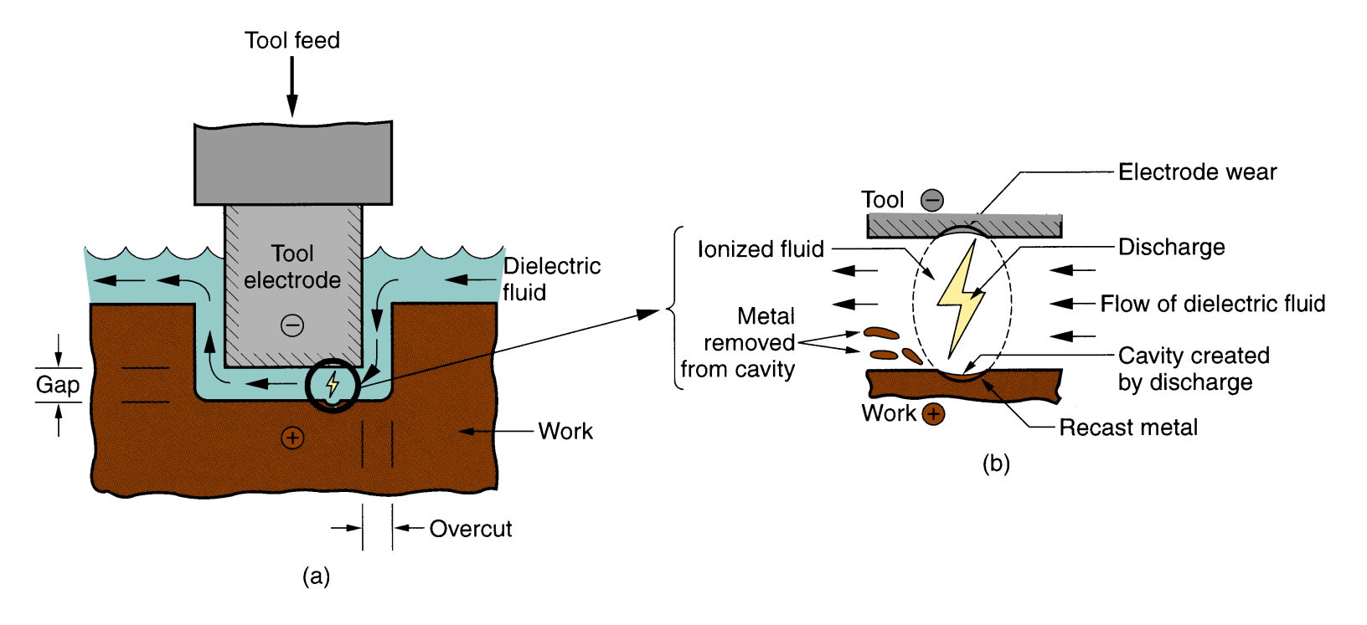
Electric Discharge Machining (EDM)
Figure 26.8 Electric discharge machining (EDM): (a) overall setup, and (b) close‑up view of gap, showing discharge and metal removal.

Slide 26
EDM Operation
One of the most widely used nontraditional processes
Shape of finished work surface produced by a shape of electrode tool
Sparks occur across a small gap between tool and work
Requires dielectric fluid, which creates a path for each discharge as fluid becomes ionized in the gap

Slide 27
Work Materials in EDM
Work materials must be electrically conducting
Hardness and strength of work material are not factors in EDM
Material removal rate depends on melting point of work material

Slide 28
EDM Applications
Tooling for many mechanical processes: molds for plastic injection molding, extrusion dies, wire drawing dies, forging and heading dies, and sheetmetal stamping dies
Production parts: delicate parts not rigid enough to withstand conventional cutting forces, hole drilling where hole axis is at an acute angle to surface, and machining of hard and exotic metals

Slide 29
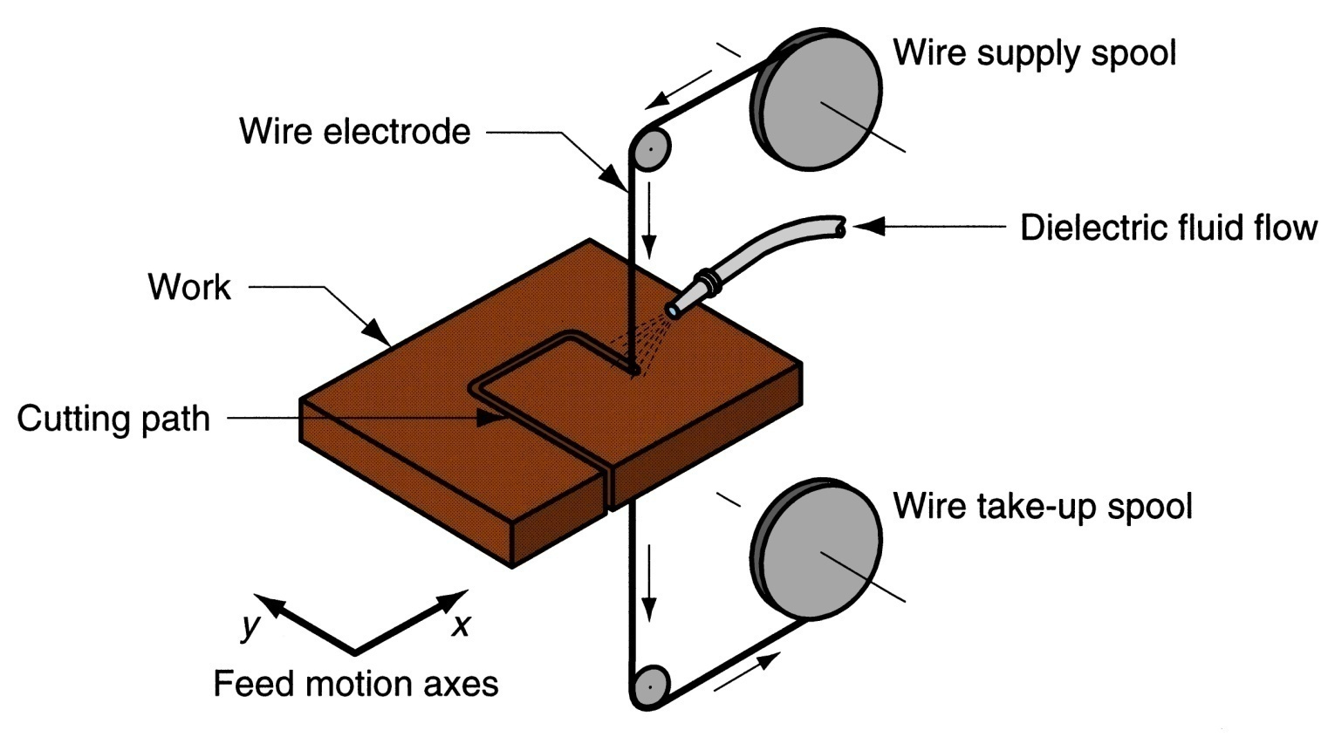
Wire EDM
Special form of EDM uses small diameter wire as electrode to cut a narrow kerf in work
Figure 26.10 Electric discharge wire cutting (EDWC).

Slide 30
Operation of Wire EDM
Work is fed slowly past wire along desired cutting path, like a bandsaw operation
CNC used for motion control
While cutting, wire is continuously advanced between supply spool and take‑up spool to maintain a constant diameter
Dielectric required, using nozzles directed at tool‑work interface or submerging workpart

Slide 31
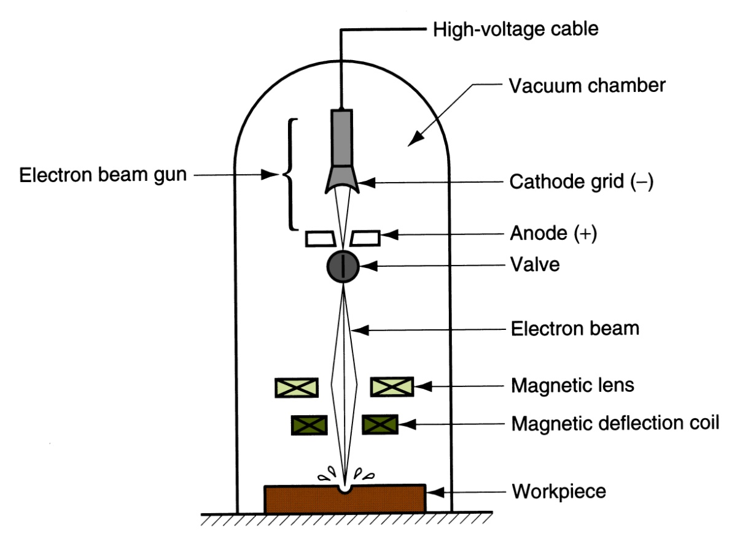
Electron Beam Machining (EBM)
Uses high velocity stream of electrons focused on workpiece surface to remove material by melting and vaporization
Figure 26.13 Electron beam machining (EBM).

Slide 32
EBM Operation
EB gun accelerates a continuous stream of electrons to about 75% of light speed
Beam is focused through electromagnetic lens, reducing diameter to as small as 0.025 mm (0.001 in)
On impinging work surface, kinetic energy of electrons is converted to thermal energy of extremely high density which melts or vaporizes material in a very localized area

Slide 33
EBM Applications
Works on any material
Ideal for micromachining
  Drilling small diameter holes ‑ down to 0.05 mm (0.002 in)
  Cutting slots only about 0.025 mm (0.001 in.) wide
Drilling holes with very high depth‑to‑diameter ratios
  Ratios greater than 100:1

Slide 34
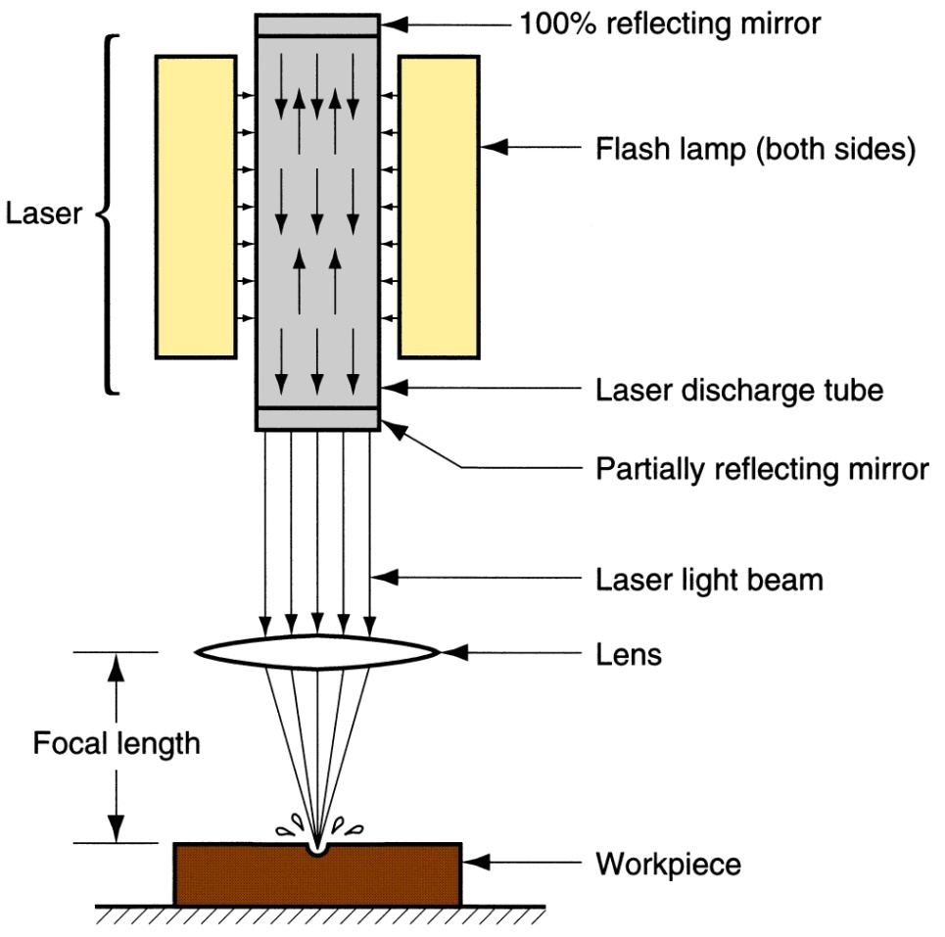
Laser Beam Machining (LBM)
Uses the light energy from a laser to remove material by vaporization and ablation
Figure 26.14 Laser beam machining (LBM).

Slide 35
Laser
Laser = Light amplification by stimulated emission of radiation"
Laser converts electrical energy into a highly coherent light beam with following properties:
  Monochromatic (single wave length)
  Highly collimated (light rays are almost perfectly parallel)
These properties allow laser light to be focused, using optical lenses, onto a very small spot with resulting high power densities

Slide 36
LBM Applications
Drilling, slitting, slotting, scribing, and marking operations
Drilling small diameter holes ‑ down to 0.025 mm (0.001 in)
Generally used on thin stock
Work materials: metals with high hardness and strength, soft metals, ceramics, glass and glass epoxy, plastics, rubber, cloth, and wood

Slide 37
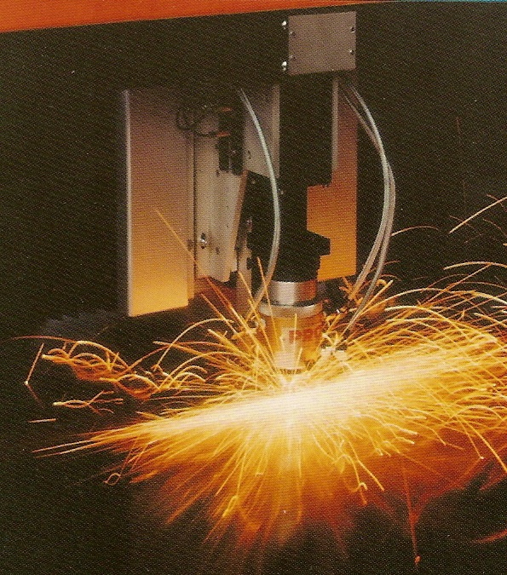
Laser beam cutting operation performed on sheet metal (photo courtesy of PRC Corp.).

Slide 38
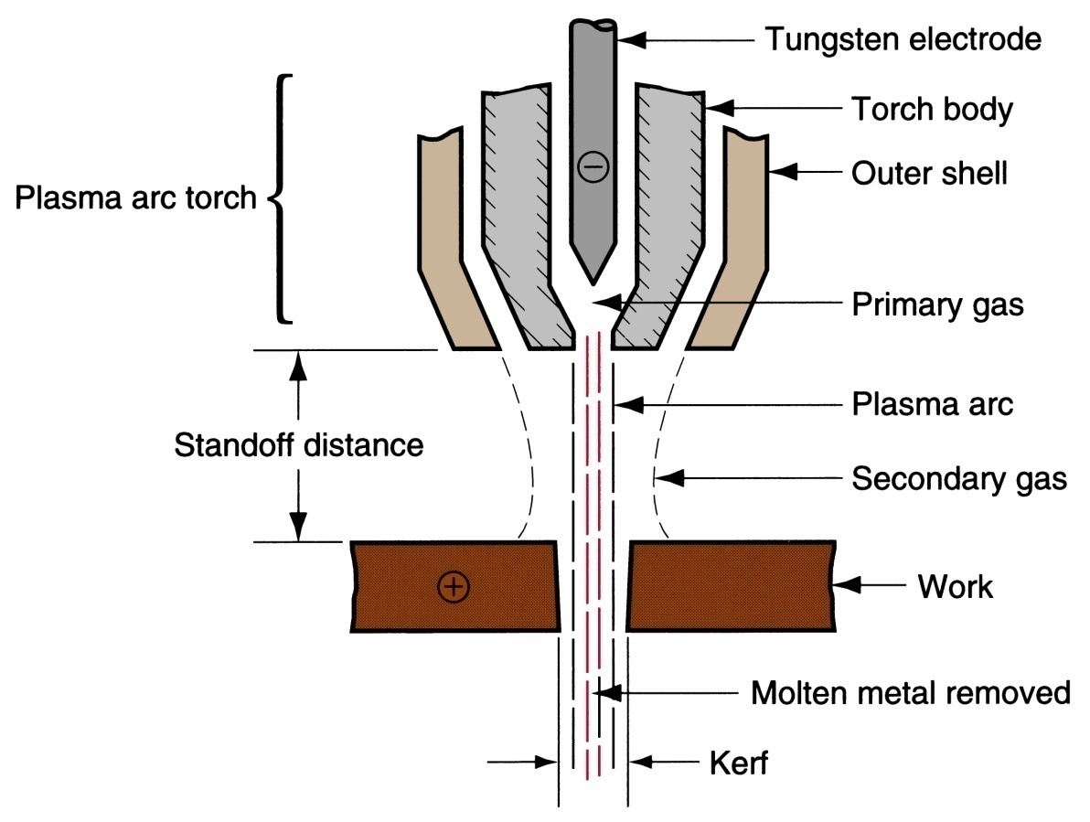
Plasma Arc Cutting (PAC)
Uses plasma stream operating at very high temperatures to cut metal by melting
Figure 26.15 Plasma arc cutting (PAC).

Slide 39
Operation of PAC
Plasma = a superheated, electrically ionized gas
PAC temperatures: 10,000°C to 14,000°C (18,000°F to 25,000°F)
Plasma arc generated between electrode in torch and anode workpiece
The plasma flows through water‑cooled nozzle that constricts and directs stream to desired location

Slide 40
Applications of PAC
Most applications of PAC involve cutting of flat metal sheets and plates
Hole piercing and cutting along a defined path
Can be operated by hand‑held torch or automated by CNC
Can cut any electrically conductive metal
Most frequently cut metals: carbon steel, stainless steel, aluminum

